Slide 1



ILPO 55
Needs and Gaps Analysis in Age management and Intergenerational activities

Slide 2
Output description
Identify existing needs and gaps in the field of age management and intergenerational cooperation
Collect and analyse examples of good practices in the filed
Identify further needed actions to be taken for engaging and supporting stakeholders in implementing the ILPO55 Reference Framework

Slide 3
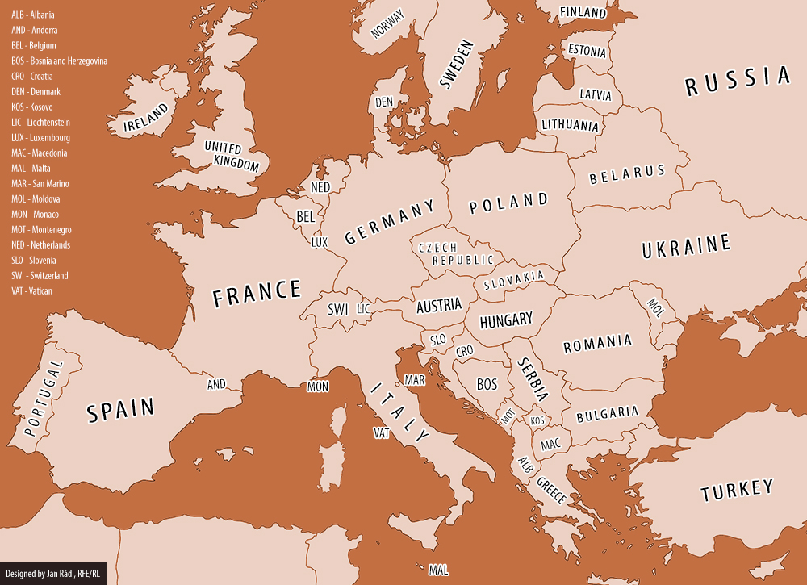
Geographical coverage of the analysis
Netherlands
Italy
Malta
Romania
Spain

Slide 4
Timeline
Survey
Focus groups
Interviews
European Report
National Reports

Slide 5
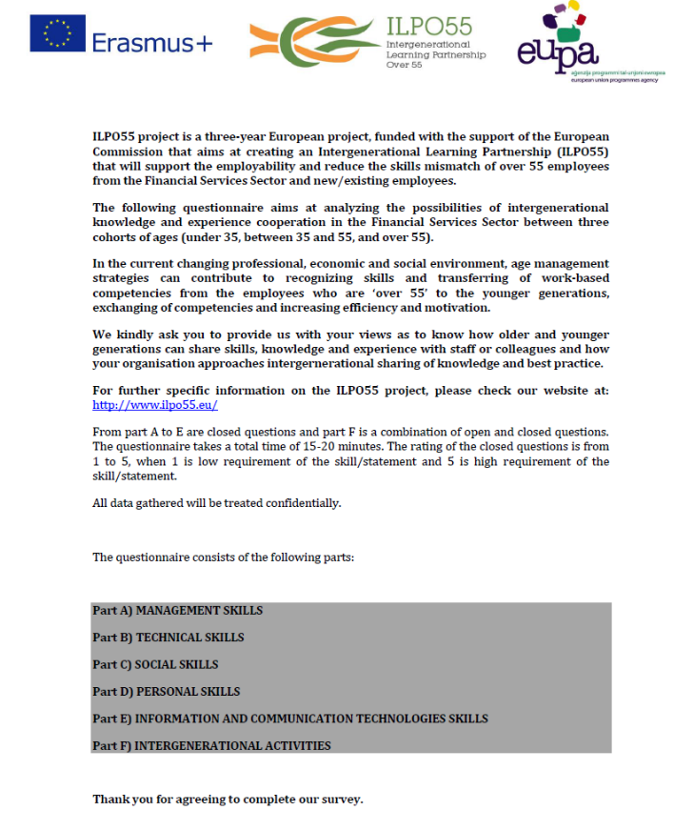
Survey Methodology
Over 55
Under 35
3 questionnaires:
Over 55
Under 35
Between 35 and 55

Slide 6
Usefulness of AGE MANAGEMENT activities
Training (f2f & online)
Mentoring
Coaching
Social responsibility activities
 | >55 | <35 | 35-55
F2f Training courses | 3,56 | 2,66 | 3,8
Online Training courses | 3,38 | 3,44 | 2,94
Mentoring | 4,08 | 4,3 | 4,06
Coaching | 3,78 | 4,24 | 4,06
Social Activities | 3,36 | 3,94 | 3,87
External intergeneration activities (cooperation) | 3,98 | 4,16 | 4
Job shadowing | 3,12 | 4,22 | 3,8

Slide 7
ILPO55 EUROPEAN FRAMEWORK will offer….
Training
“Become….”
Adult trainer
Mentoring
“Action plan”tools & practices
Social Responsibility Facilitator
Coaching
Social Responsability Facilitator
Collaborative communities
Professional consultant
Self-assessment tools for individual competencies (Knowledge, Skills and Competencies)
Assess your NEEDS
Want to network?
Guidance on national legislation, opportunities for employability, etc.
Good practices
Check INFORMATION

